Slide 1

Imputation Methods for
Missing
Data
Dr Arun Ayyar

Slide 2

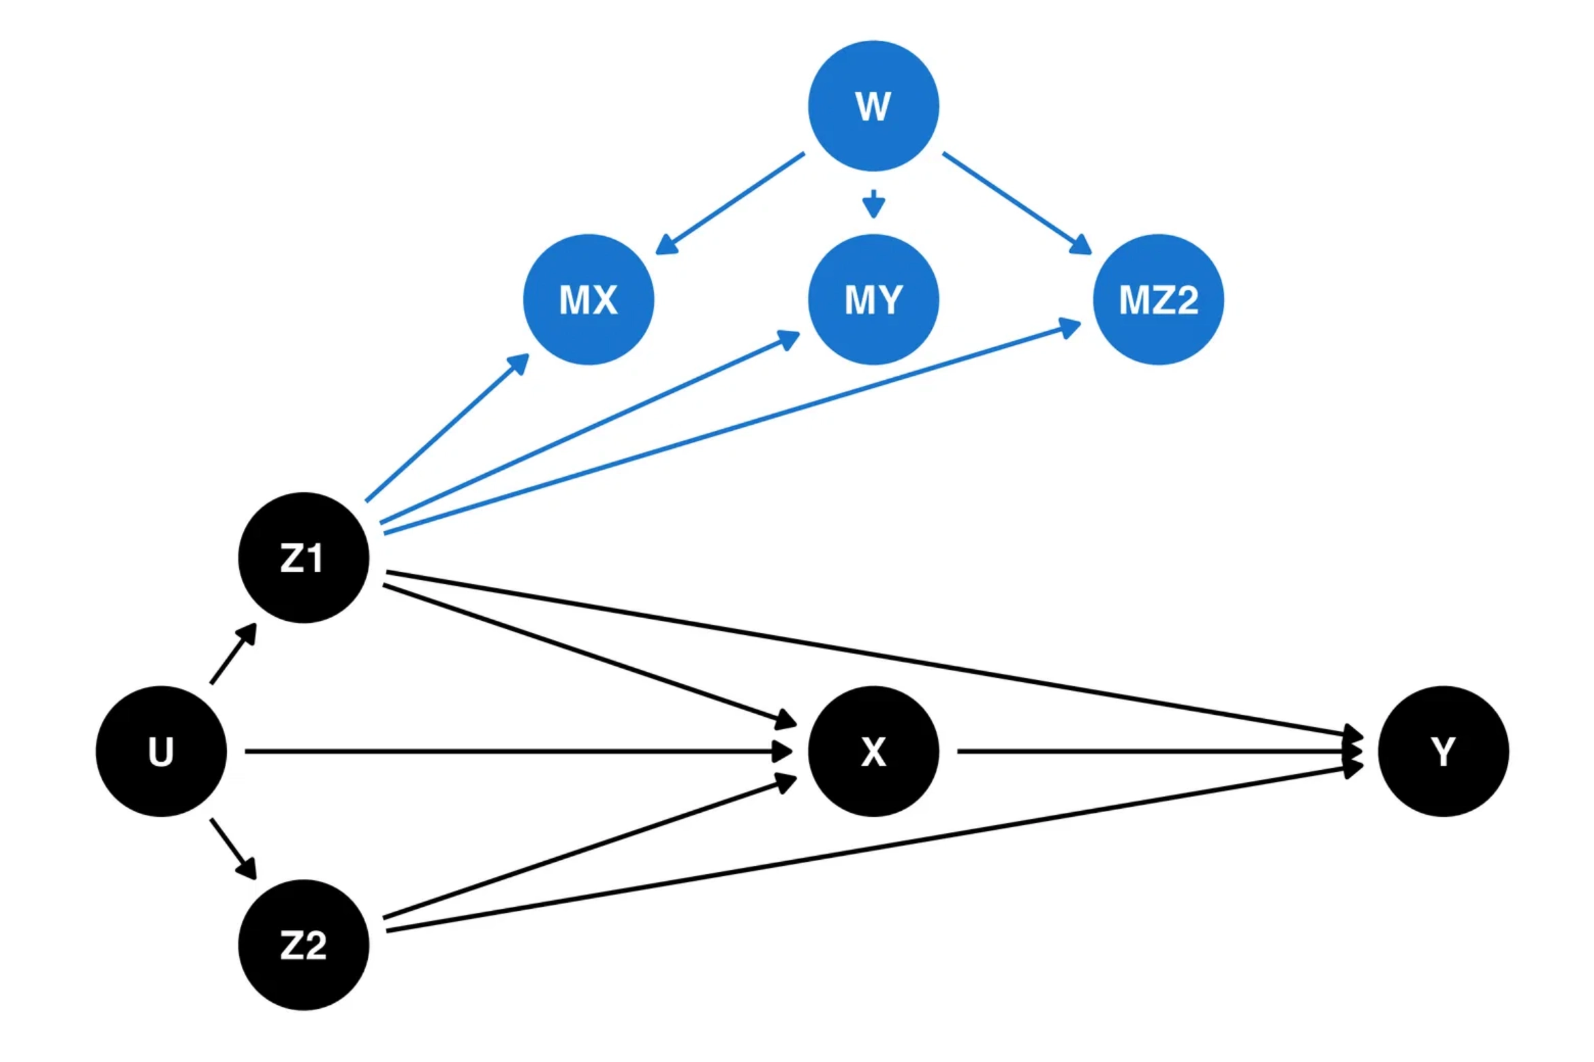
Review of Missing Data Mechanisms
Missing Completely At Random (MCAR)
Probability of missingness is the same for all units. Missing values are not related to any observed or unobserved data.
Missing At Random (MAR)
Probability of missingness depends only on observed data. Missing values can be predicted from other variables in the dataset.
Missing Not At Random (MNAR)
Probability of missingness depends on unobserved data. Missing values are related to the values that would have been observed.
Tests to Identify
Little's MCAR test, pattern analysis, and sensitivity analysis help determine the missing data mechanism.

Slide 3
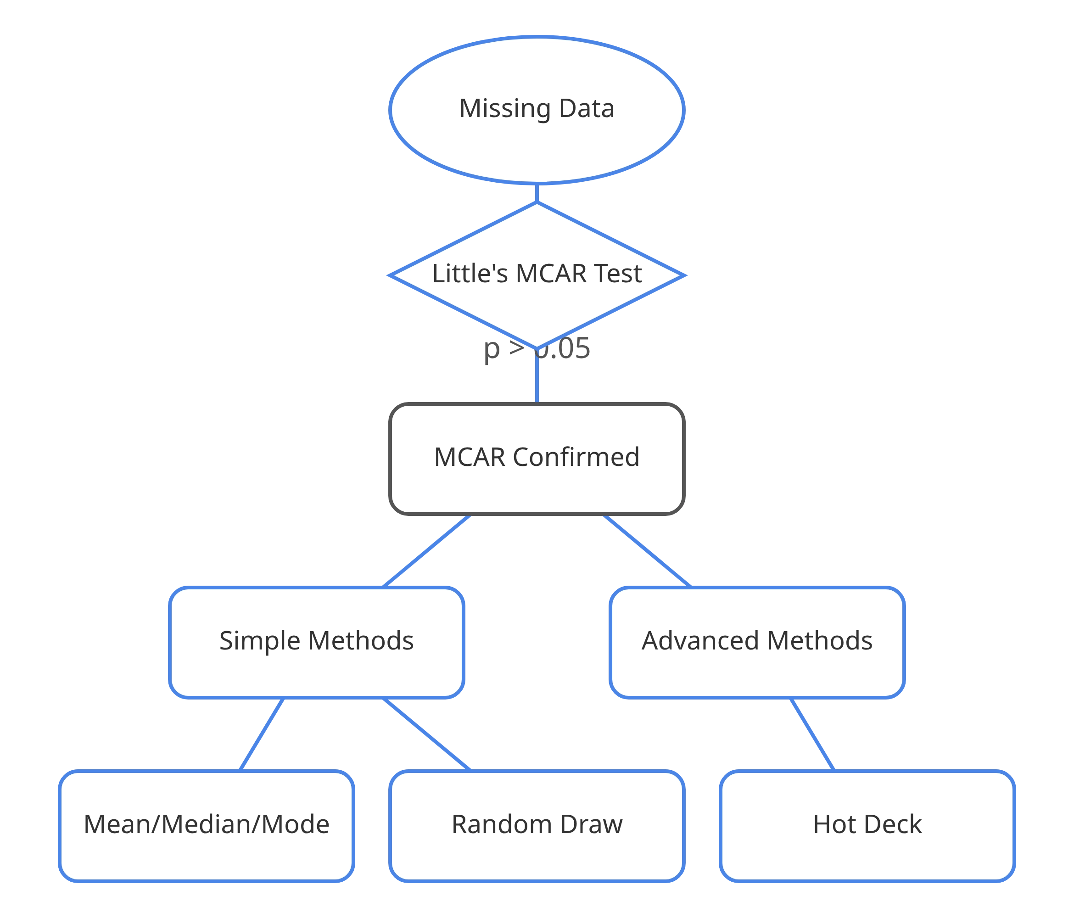



MCAR Imputation Methods Overview
When to Use MCAR Methods
Use when missing data is completely random and not related to any observed or unobserved variables. Confirmed by Little's MCAR test (p > 0.05).
Key Considerations
Simple methods work well under MCAR but may distort distributions and relationships between variables. Consider sample size and proportion of missing data.
MCAR Imputation Methods
Mean/Median/Mode Imputation
Random Draw Imputation
Hot Deck Imputation

Slide 4
Mean/Median/Mode Imputation: Intuitive Explanation
The Concept
Imagine you have a list of people's ages, but some are missing. The simplest way to fill the gaps is to calculate the average age of the people you do have information for and use that average for everyone who is missing an age.
When to Use
• When data is Missing Completely At Random (MCAR)
• When simplicity is more important than precision
• When missing data percentage is small (<5%)
Real-World Analogy
Like estimating the average height of students in a class when some measurements are missing. You measure the heights of available students, calculate the average, and assume the missing students are also of average height.

Slide 5
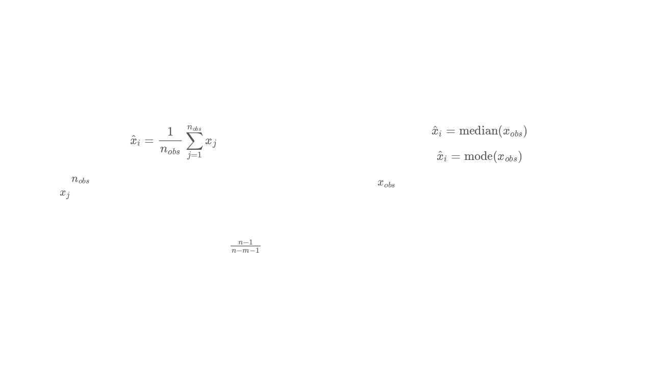




Mean/Median/Mode Imputation: Mathematical Formulation
Mean Imputation
Median and Mode Imputation
Where
is the number of observed values in the variable,
Where
o
b
s
is the set of observed values in the variable.
and
j
represents each observed value.
Median: Robust to outliers in the observed data
Preserves the mean of the observed data
Mode: Appropriate for categorical variables
Underestimates the variance by a factor of
−
Both distort the original distribution
Statistical Properties Under MCAR
Unbiased estimator of the population mean
Biased estimator of variance and covariance
Consistent as sample size increases
Creates artificial peaks in the distribution

Slide 6
Random Draw Imputation: Intuitive Explanation
The Hat Analogy
Instead of using the average age, you write down all the known ages on pieces of paper, put them in a hat, and for each missing age, you draw one piece of paper from the hat and use that age. This keeps the variety of ages more realistic.
Why It Works
Real-world Example:
Random draw preserves the natural distribution of your data, including its variance and shape. Unlike mean imputation, which creates an artificial spike at the mean value, random draw maintains the original data pattern.
In a survey about favorite colors, some responses are missing. Instead of using the most common color for all missing values, randomly select from the observed colors to maintain the natural variety in preferences.
When To Use
Best for MCAR data when preserving the distribution is important, but relationships between variables are not critical. Particularly useful for categorical variables where mean imputation isn't applicable.

Slide 7
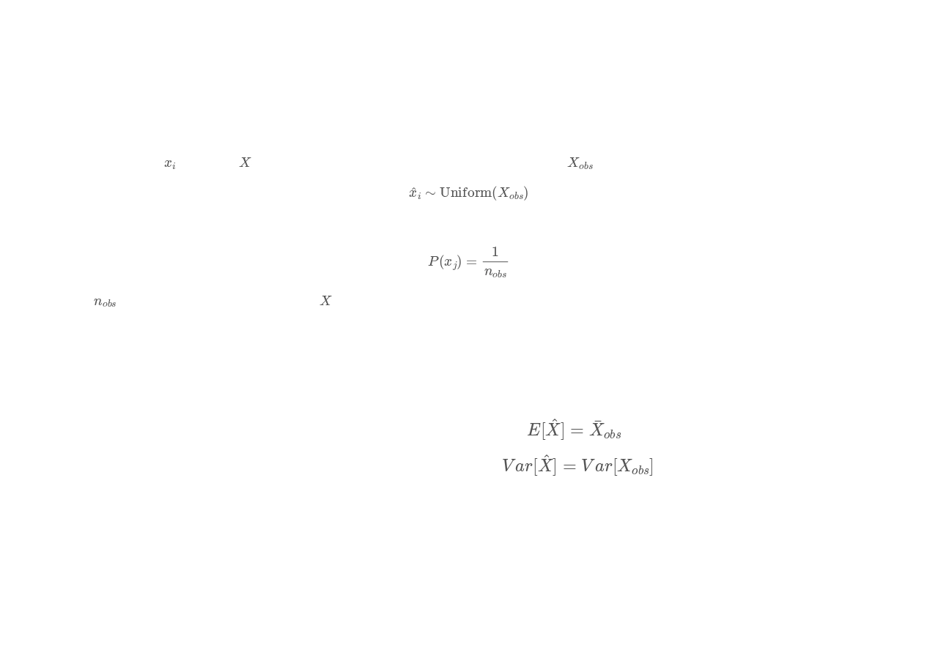







Random Draw Imputation: Mathematical Formulation
Mathematical Definition
For a missing value
in variable
, draw a value at random from the set of observed values
Probability of selecting any observed value:
Where
is the number of observed values in
.
Statistical Properties
Preserves the empirical distribution of the observed data
Expected value of imputed data equals the mean of observed data:
Variance of imputed data equals the variance of observed data:
Advantages
Limitations
Preserves distribution variance better than mean imputation
Ignores relationships between variables
Maintains the shape of the original observed distribution
May introduce additional noise in the imputed values
Simple to implement and computationally efficient
Not suitable for small sample sizes with few observed values

Slide 8

Hot Deck Imputation: Intuitive Explanation
What is Hot Deck Imputation?
Hot deck imputation replaces missing values with observed values from similar records ("donors") in the same dataset.
The Concept
You find a person in your dataset who is very similar to the person with the missing value (e.g., same gender, similar education level). You then "borrow" the value from that similar person (the "donor") to fill in the missing value.
Real-World Analogy
Like asking a friend with a similar background for advice when you don't know something. You trust their answer because they're similar to you in relevant ways.
Key Benefits
Maintains realistic values and preserves the natural distribution of the data. Uses actual observed values rather than calculated ones.

Slide 9
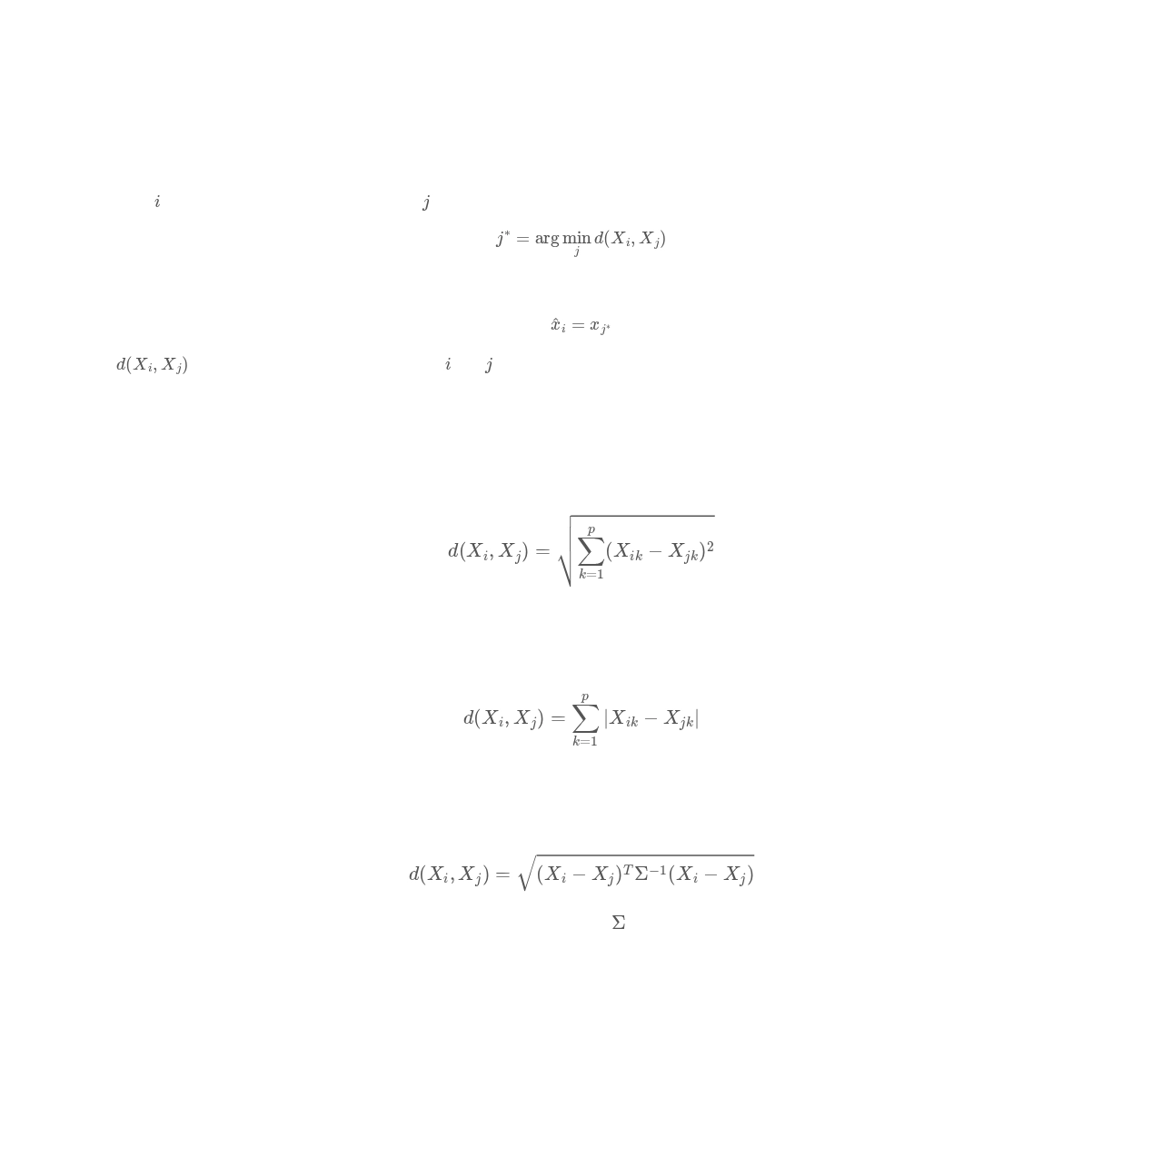
Hot Deck Imputation: Mathematical Formulation
Mathematical Definition
For a record
with missing value, find donor record
that minimizes distance:
Then impute the missing value with the corresponding value from the donor:
Where
is a distance metric between records
and
based on observed variables.
Common Distance Metrics
Euclidean Distance
Straight-line distance between two points in Euclidean space
Manhattan Distance
Sum of absolute differences between coordinates
Mahalanobis Distance
Accounts for correlations between variables using the covariance matrix
Advantages
Limitations
Maintains realistic values from actual observations
Complexity in finding appropriate donors
Preserves distributions and relationships between variables
Sensitive to choice of distance metric
Works well for both continuous and categorical variables
Computationally intensive for large datasets

Slide 10
Hot Deck Imputation: Mathematical Formulation
Example
Age | Gender | Education | Income
25 | M | Bachelor | 30k
26 | F | Master | ?
40 | M | PhD | 70k
27 | F | Master | 32k
Missing: Person 2 (26F, Master).
Distance-based matching:
Compare Person 2 to others using Age + Gender + Education.
Closest donor = Person 4 (27F, Master, 32k).
Impute Person 2’s Income = 32k. Nearest Neighbor Hot Deck = “Find the most similar observed case using distance, and copy its value.” It’s more accurate because it respects relationships, but requires careful choice of matching variables and distance measure.

Slide 11

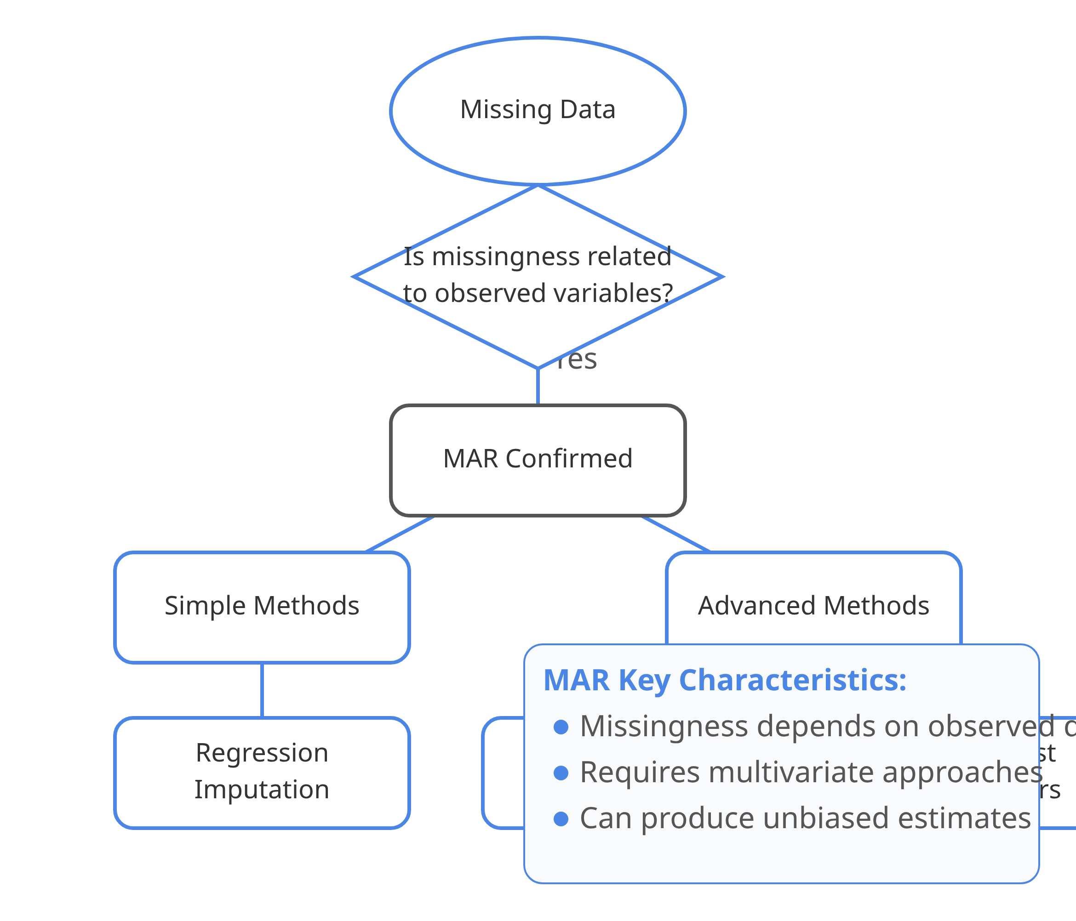



MAR Imputation Methods Overview
When to Use MAR Methods
Use when missing data depends on observed variables but not on the missing values themselves. For example, income data may be missing more often for younger people, but the missingness is not related to the income amount itself.
Key Considerations
MAR methods leverage relationships between variables to make more informed imputations. They require identifying which observed variables are related to the missingness pattern.
MAR Imputation Methods
Regression Imputation
Multiple Imputation by Chained Equations (MICE)
k-Nearest Neighbors (kNN) Imputation

Slide 12

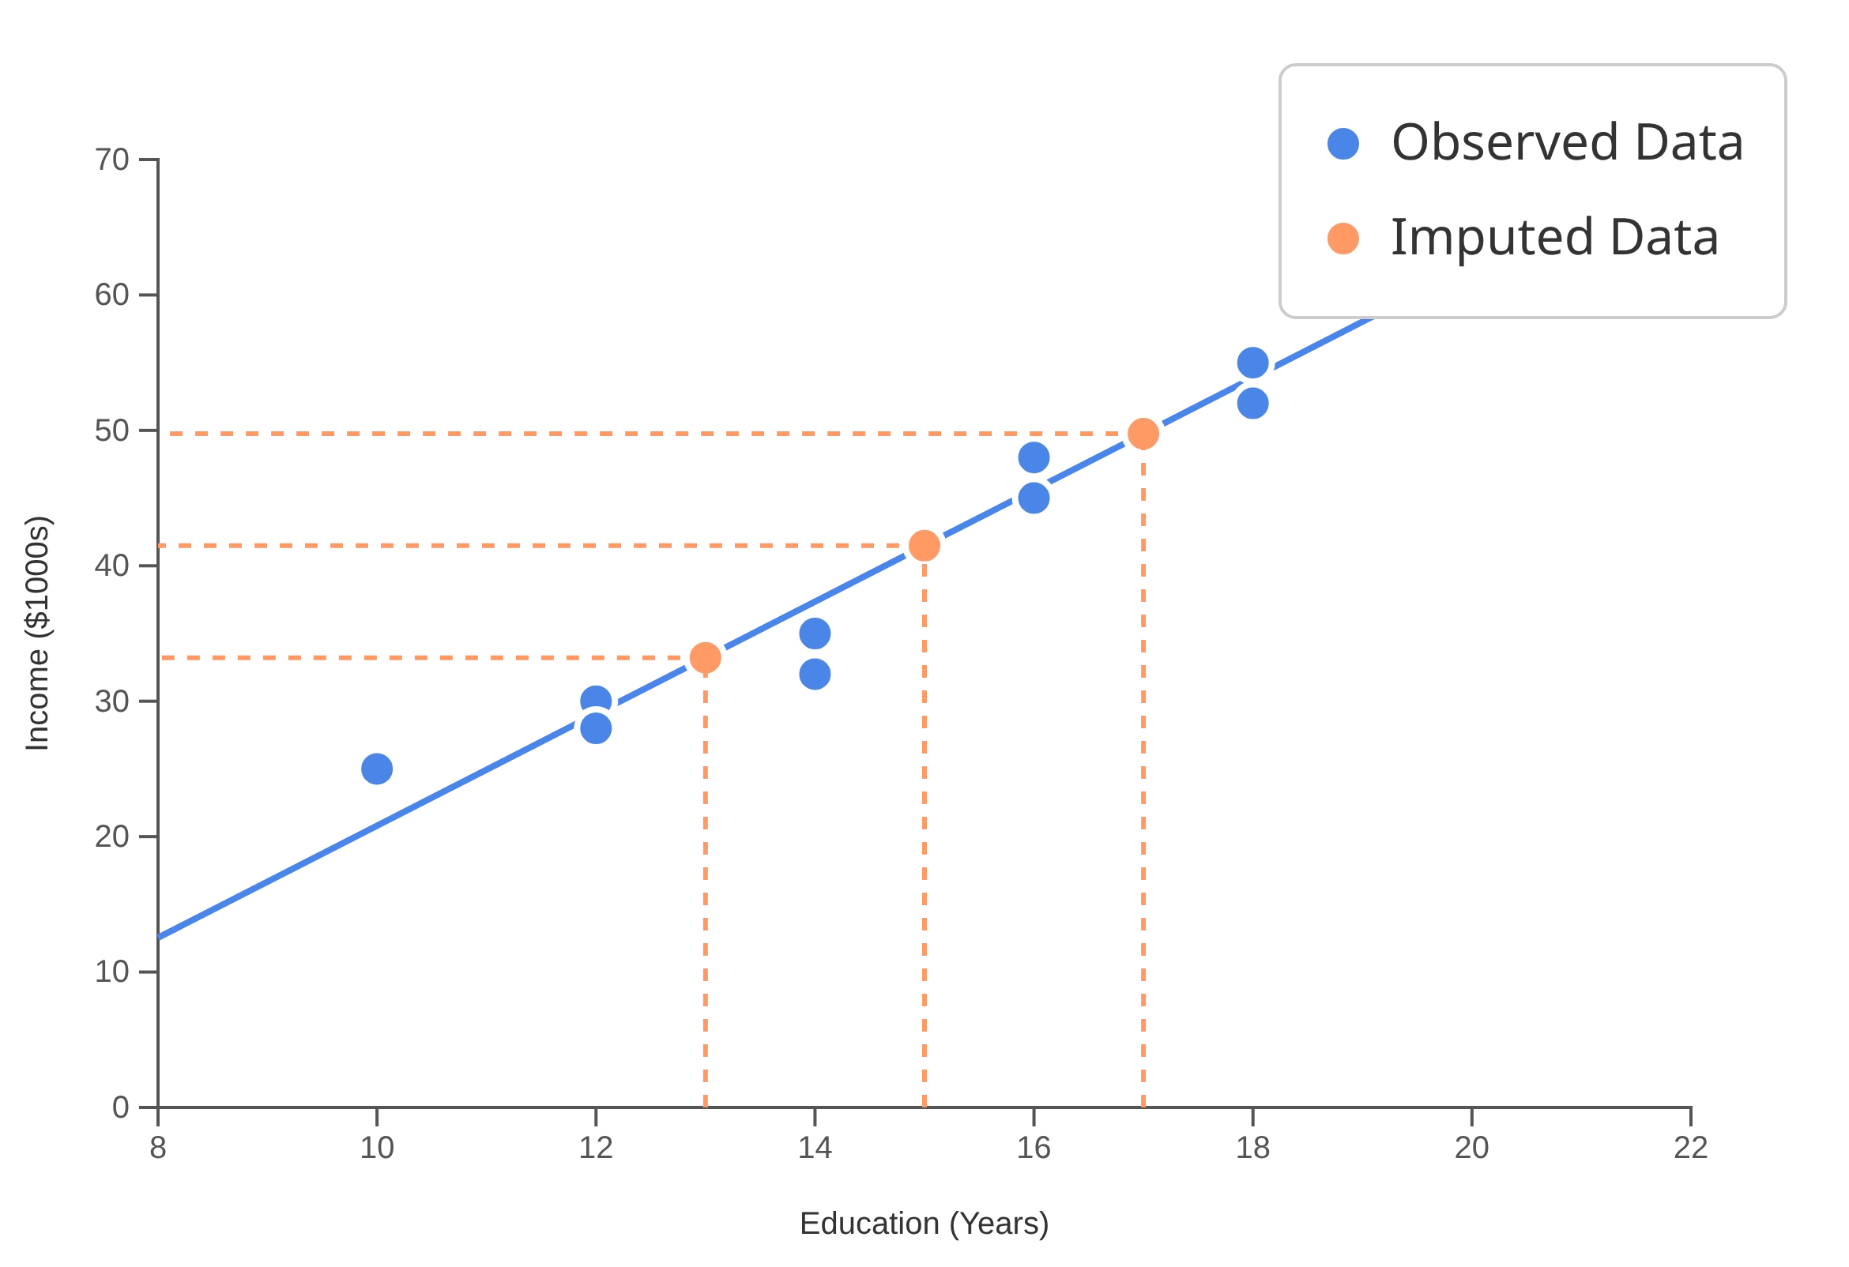
Regression Imputation: Intuitive Explanation
The Concept
You notice a pattern: people with more education tend to have higher incomes. You create a rule (a regression model) that predicts income based on education. Then, for a person with a missing income but known education level, you use your rule to predict their income.
When to Use
• When data is Missing At Random (MAR)
• When relationships between variables are strong
• When preserving relationships is more important than
preserving distributions
Real-World Analogy
Like predicting house prices based on size and location. If you know the size and location of a house but not its price, you can estimate the price based on similar houses in the area.

Slide 13
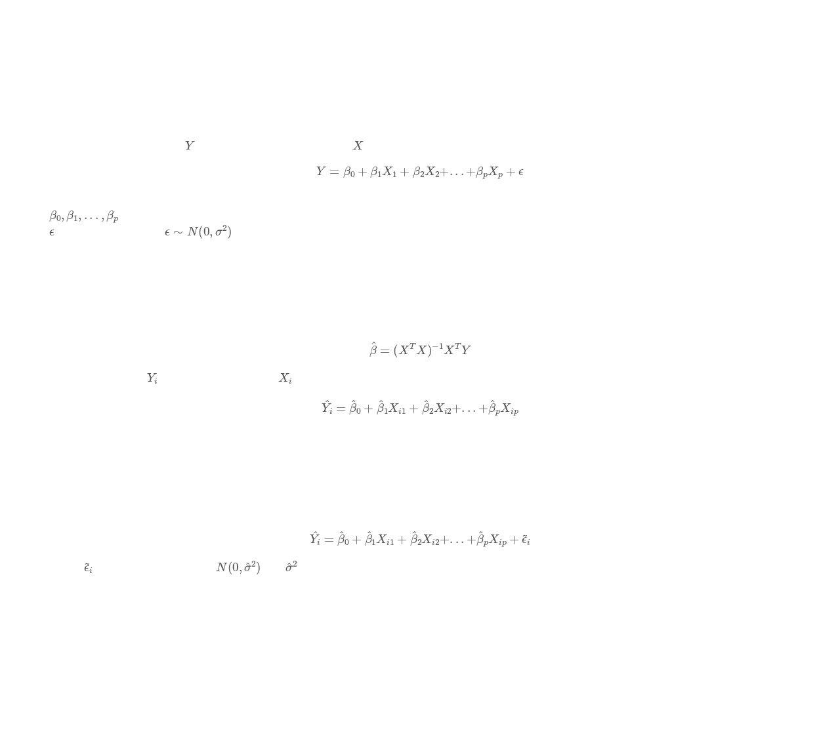


Regression Imputation: Mathematical Formulation
Linear Regression Model
Model the missing variable
as a function of other variables
:
Where:
are regression coefficients
is the error term with
Parameter Estimation
Estimate parameters using complete cases:
For a missing value
, predict using observed
values:
Stochastic Regression Imputation
Add random noise to preserve variance:
Where
is randomly drawn from
is the estimated residual variance.
Advantages
Limitations
Leverages relationships between variables
Can overfit with many predictors
More accurate than mean imputation when correlations exist
Deterministic version underestimates variance
Stochastic version preserves variance
Assumes linear relationships between variables

Slide 14
Regression Imputation: Mathematical Formulation
Linear Regression Model
Age | Education | Income
25 | Bachelor | 30k
30 | Master | 40k
35 | PhD | ?
40 | Master | 55k
Regression model (from complete cases): Income^=5k+0.8k⋅Age+10k⋅Education
For Age=35, Education=PhD → Predicted Income = 63k.
Deterministic: Impute exactly 63k.

Slide 15
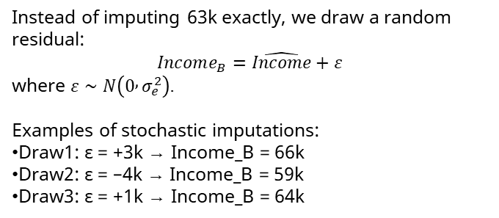
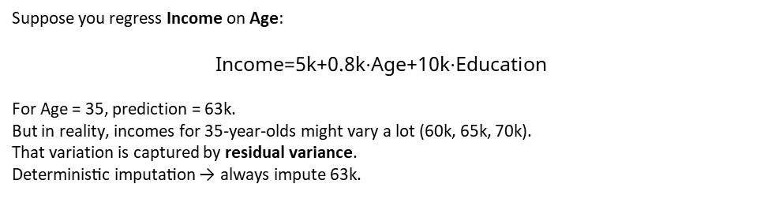
Regression Imputation: Example
Stochastic Regression Model
Age | Education | Income
25 | Bachelor | 30k
30 | Master | 40k
35 | PhD | ?
40 | Master | 55k
Suppose you regress Income on Age:
$$\text{Income}\text{=}\text{5}\text{k}\text{+}\text{0}\text{.}\text{8}\text{k}\text{⋅}\text{Age}\text{+}\text{10}\text{k}\text{⋅}\text{Education}$$
For Age = 35, prediction = 63k.
But in reality, incomes for 35-year-olds might vary a lot (60k, 65k, 70k).
That variation is captured by residual variance.
Deterministic imputation → always impute 63k.
Instead of imputing 63k exactly, we draw a random residual:
$$Income_{B}=\hat{Income}+ε$$
where $ε∼N\left(0 , σ_{e}^{2}\right)$.
Examples of stochastic imputations:
Draw1: ε = +3k → Income_B = 66k
Draw2: ε = –4k → Income_B = 59k
Draw3: ε = +1k → Income_B = 64k
Advantages
Limitations
Leverages relationships between variables
Can overfit with many predictors
More accurate than mean imputation when correlations exist
Deterministic version underestimates variance
Stochastic version preserves variance
Assumes linear relationships between variables

Slide 16

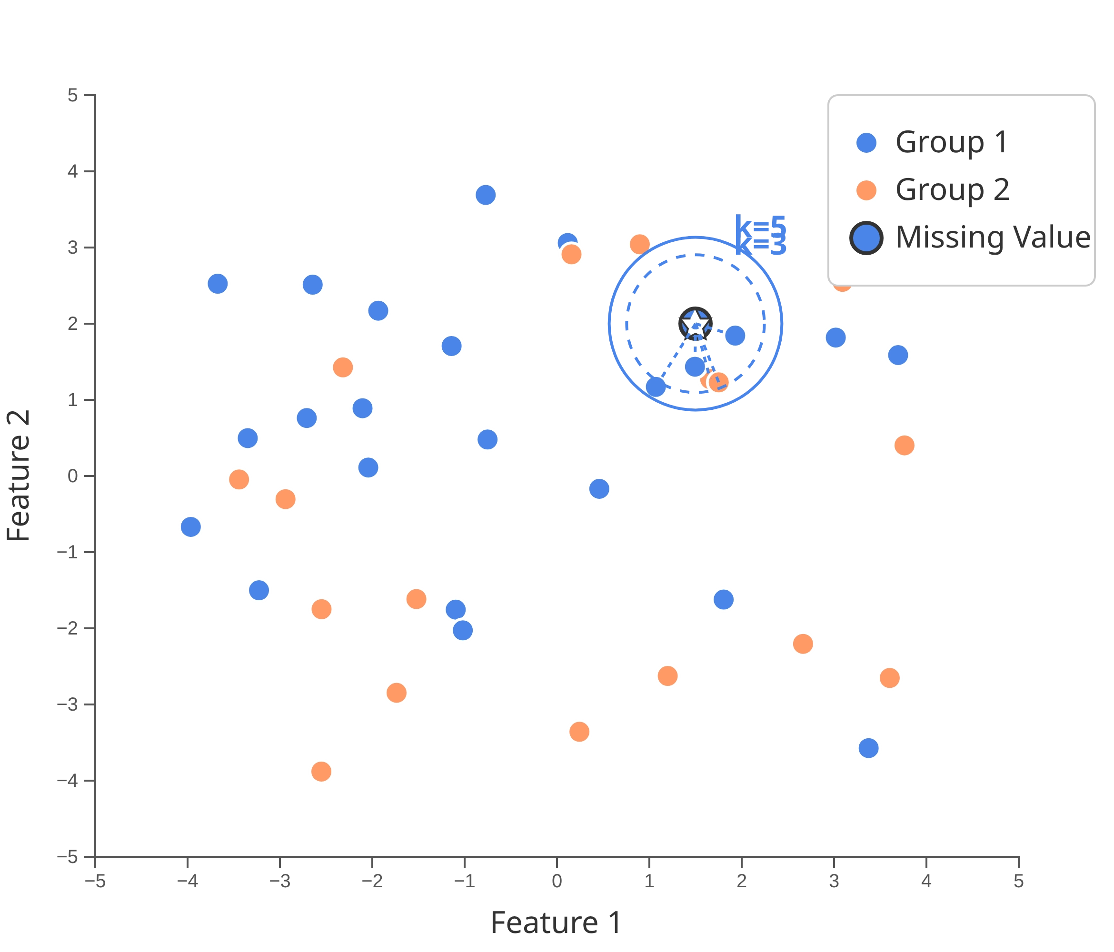
k-Nearest Neighbors Imputation: Intuitive Explanation
The Concept
To fill a missing value, you find the 'k' most similar data points (the "neighbors") based on other available information. You then take the average of the values from those neighbors to fill the gap.
When to Use
• When data is Missing At Random (MAR)
• When relationships between variables are complex or non-
linear
• When preserving local patterns in the data is important
Real-World Analogy
Like asking advice from your k closest friends. If you don't know what movie to watch, you might ask your 5 friends with the most similar taste in movies and go with their average recommendation.
Choosing k
Smaller k values capture local patterns but may be sensitive to noise. Larger k values provide more stable estimates but may smooth out important variations.

Slide 17
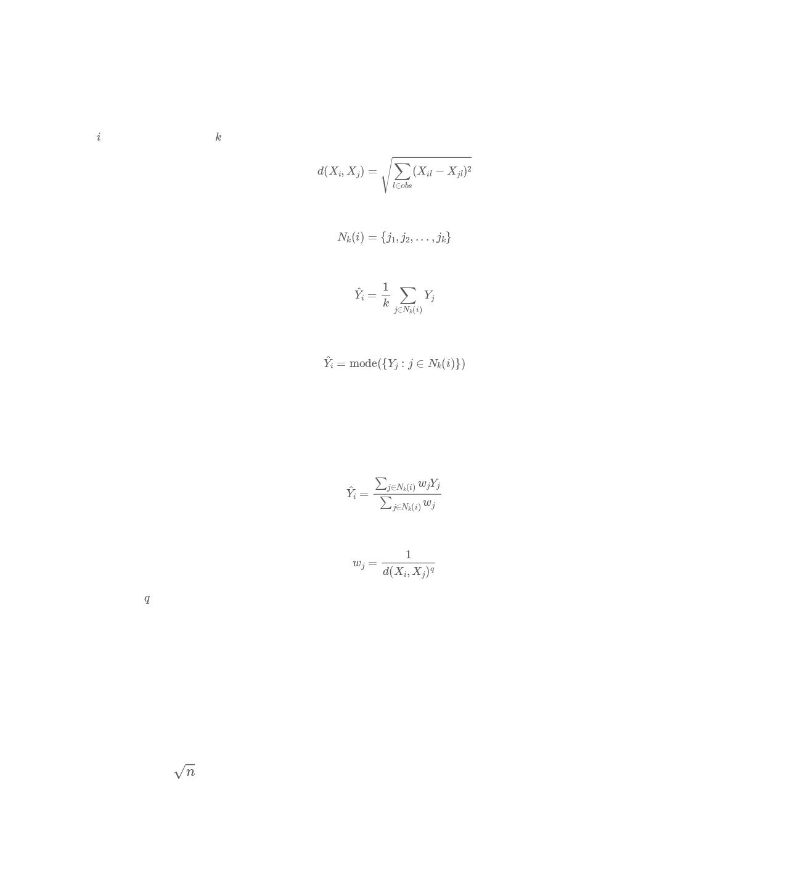



k-Nearest Neighbors Imputation: Mathematical Formulation
Mathematical Definition
For record
i
with missing value, find
k
nearest neighbors based on observed variables:
Select k-nearest neighbors:
Impute missing value:
For categorical variables:
Distance Weighting
Weighted average based on distance:
Where weights are inversely proportional to distance:
Common choices for
are 1 or 2.
Advantages
Limitations
Non-parametric: no assumptions about data distribution
Sensitive to choice of distance metric
Preserves complex relationships between variables
Computationally expensive for large datasets
Works well for both continuous and categorical variables
Requires careful selection of k (number of neighbors)
Parameter Selection
Choice of k: typically
where n is sample size
Distance metric: Euclidean, Manhattan, Mahalanobis
Variable scaling: standardization or normalization

Slide 18
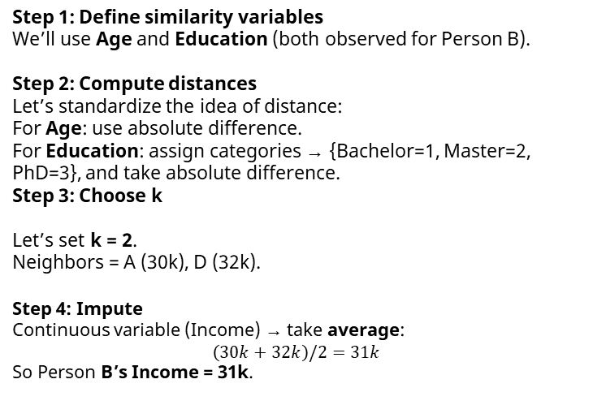
k-Nearest Neighbors Imputation: Example
Person | Age | Education | Income
A | 25 | Bachelor | 30k
B | 26 | Master | ?
C | 40 | PhD | 70k
D | 27 | Master | 32k
Step 1: Define similarity variables
We’ll use Age and Education (both observed for Person B).
Step 2: Compute distances
Let’s standardize the idea of distance:
For Age: use absolute difference.
For Education: assign categories → {Bachelor=1, Master=2, PhD=3}, and take absolute difference.
Step 3: Choose k
Let’s set k = 2.
Neighbors = A (30k), D (32k).
Step 4: Impute
Continuous variable (Income) → take average:
$$\left(30k+32k\right)/2=31k$$
So Person B’s Income = 31k.
compute distance between Person B and others:
B vs A (25, Bachelor, 30k)
Age difference = |26 – 25| = 1
Education difference = |2 – 1| = 1
Total distance = 2
B vs C (40, PhD, 70k)
Age difference = |26 – 40| = 14
Education difference = |2 – 3| = 1
Total distance = 15
B vs D (27, Master, 32k)
Age difference = |26 – 27| = 1
Education difference = |2 – 2| = 0
Total distance = 1
So nearest neighbors of B are: D (dist=1), A (dist=2).

Slide 19

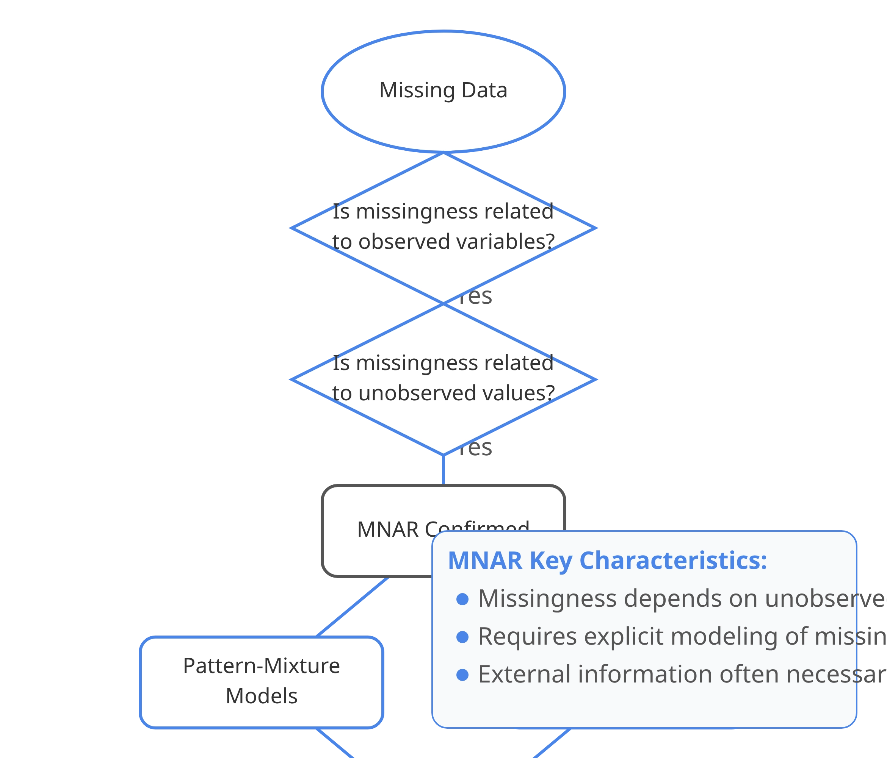


MNAR Imputation Methods Overview
When to Use MNAR Methods
Use when the probability of missingness depends on the unobserved values themselves. For example, people with very high incomes may be less likely to report their income, or patients with severe symptoms may be more likely to miss follow-up appointments.
Key Considerations
MNAR is the most challenging missing data mechanism to handle. It requires explicit modeling of the missingness mechanism or incorporating external information. Sensitivity analysis is often necessary to assess the impact of different assumptions.
MNAR Imputation Methods
Pattern-Mixture Models
Domain Knowledge / Auxiliary Data Approaches

Slide 20

Pattern-Mixture Models: Intuitive Explanation
The Concept
You suspect that the reason a value is missing is important.
So, you divide your data into groups based on
what
is missing.
You then build a separate model for each group and combine
the results. For example, people who don't report their
income might have a different income distribution than those
who do.
When to Use
• When data is Missing Not At Random (MNAR)
• When the missingness pattern itself contains information
• When you can identify distinct patterns of missingness
Real-World Analogy
Like analyzing survey responses separately for people who skip different questions. If some people skip the income question but answer everything else, while others skip the health questions but answer income, these groups might have fundamentally different characteristics.

Slide 21

Domain Knowledge Approaches: Intuitive Explanation
The Concept
You use outside information to help fill in the gaps. For example, if you're missing income data for doctors, you might use public salary survey data for doctors to inform your imputations.
When to Use
• When data is Missing Not At Random (MNAR)
• When external information about the missing values is
available
• When you have strong domain expertise about the data
Real-World Analogy
Like a detective using multiple sources of evidence to reconstruct what happened. When direct evidence is missing, the detective uses contextual clues and expert knowledge to fill in the gaps.
Examples of External Information
• Follow-up surveys or interviews
• Public datasets or industry benchmarks
• Expert knowledge about plausible ranges

Slide 22
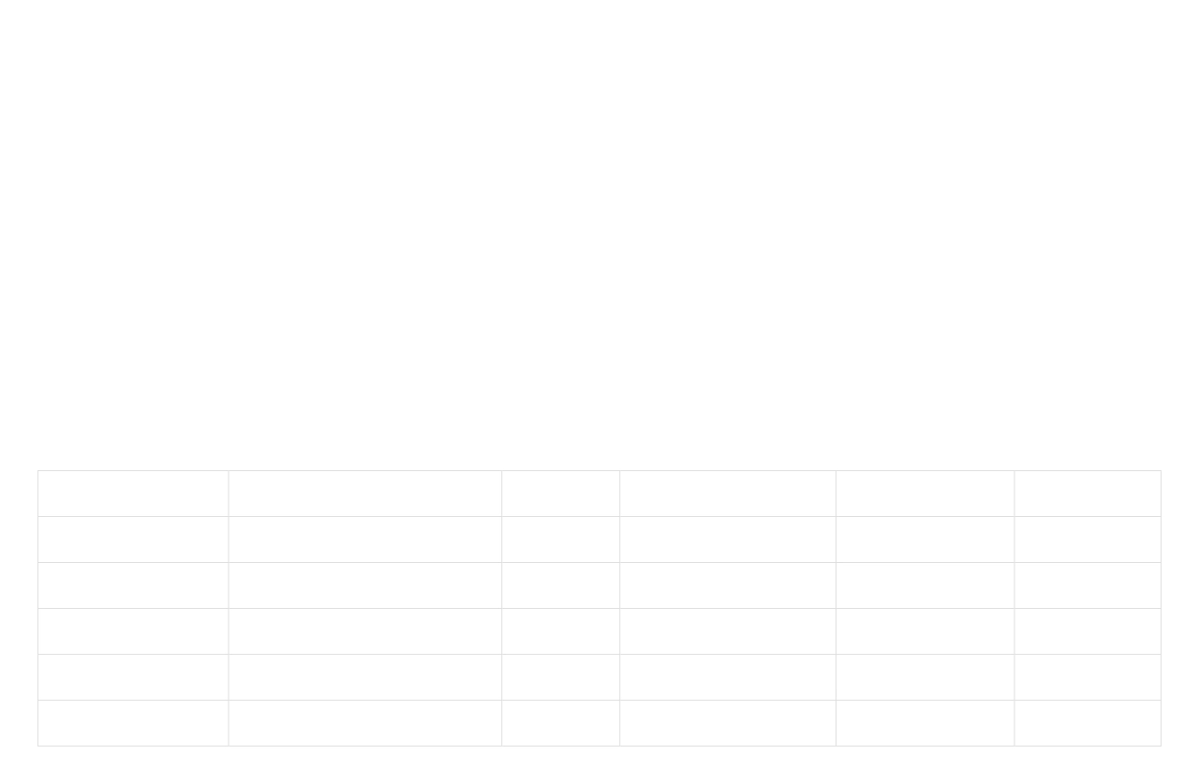
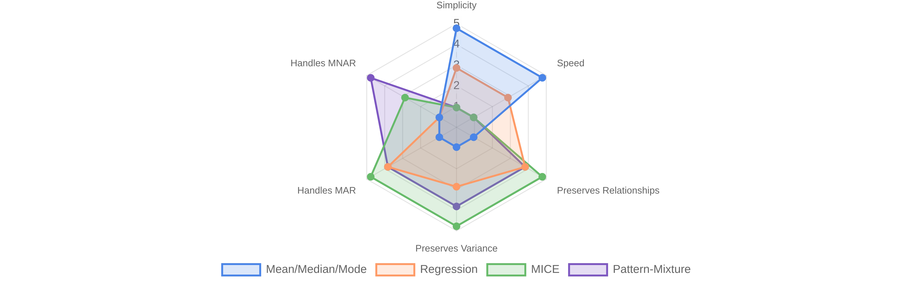
Comparison of Imputation Methods
Method
Best For
Complexity
Preserves Relationships
Preserves Variance
Handles MNAR
Mean/Median/Mode
MCAR, Simple analysis
Low
No
No
No
Random Draw
MCAR, Distribution preservation
Low
No
Yes
No
Hot Deck
MCAR, Realistic values
Medium
Partial
Yes
No
Regression
MAR, Linear relationships
Medium
Yes
Partial
No
MICE
MAR, Complex relationships
High
Yes
Yes
Partial
Pattern-Mixture
MNAR, Sensitivity analysis
High
Yes
Yes
Yes

Slide 23

Method Selection Guide
Key Selection Factors
Choosing the right imputation method depends on several factors including the missing data mechanism, analysis goals, and computational resources.
Key Questions to Ask
What is the missing data mechanism? (MCAR, MAR, MNAR)
How important is preserving relationships between variables?
How important is preserving the variance of the data?
What computational resources are available?
Is the analysis exploratory or confirmatory?

Slide 24


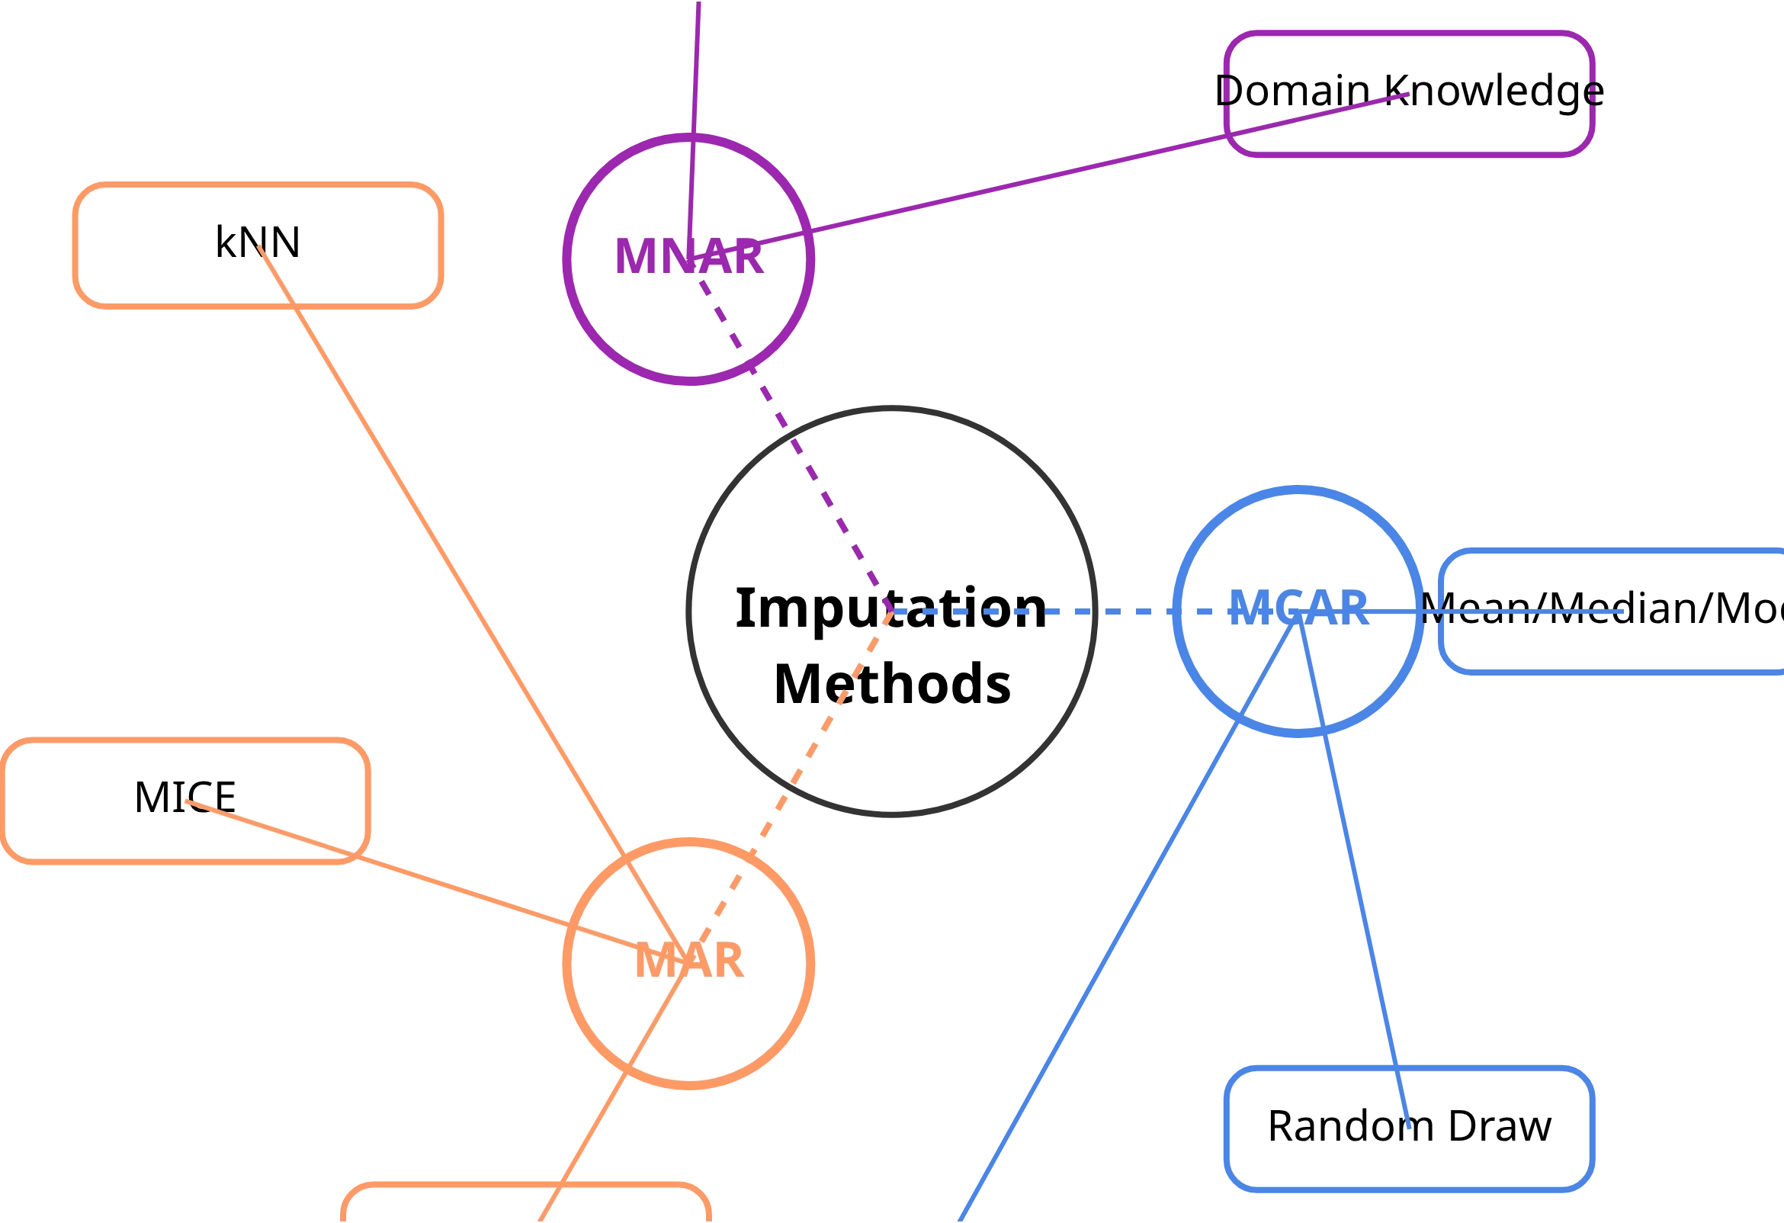


Conclusion: Imputation Methods Summary
Key Takeaways
The missing data mechanism (MCAR, MAR, MNAR) should guide your imputation method selection
Simple methods work well for MCAR data but may introduce bias for MAR and MNAR
Advanced methods like MICE and pattern-mixture models better preserve relationships and handle complex missingness
Always validate imputation results through sensitivity analysis
Further Resources
Little, R.J.A. and Rubin, D.B. (2019). Statistical Analysis with Missing Data, 3rd Edition.
Python: scikit-learn imputation modules and fancyimpute package

